Slide 1


Stochastic On Time Arrival Problem (Jensen’s Inequality Analysis)
Project Milestone - 02
Abdulwahab Shaikh - AU2440099
Dhruvi Chavda - AU2440236
CSE 400: Fundamentals of Probability in Computing

Slide 2
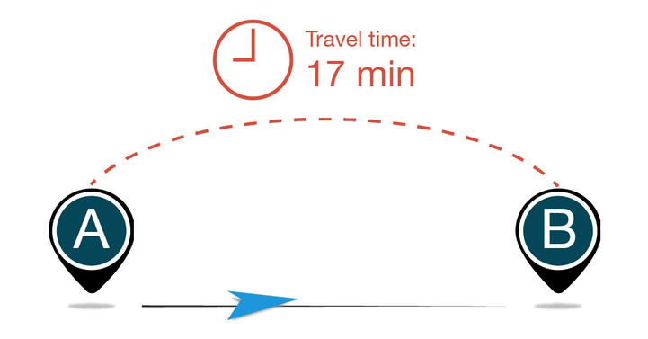
Recap
Stochastic On Time Arrival
Travel time is stochastic and a Random Variable
Objective: maximize P(T≤D)
Network modeled as graph G(V,E)
Dynamic programming framework

Slide 3
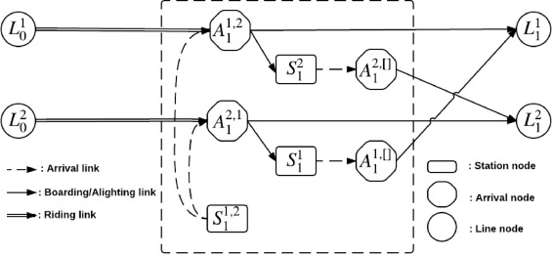
Goal
To find the most reliable path rather than the path with the shortest route
Random Variable → Travel Time

Slide 4
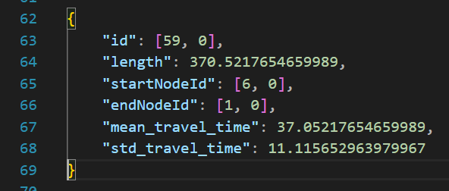
Dataset & Travel Time Modelling
Each road is considered as an edge and it has
length
Identifier
Mean travel time
Standard travel time
We are using a small sample of around 60 Nodes from the data collected by online sources

Slide 5
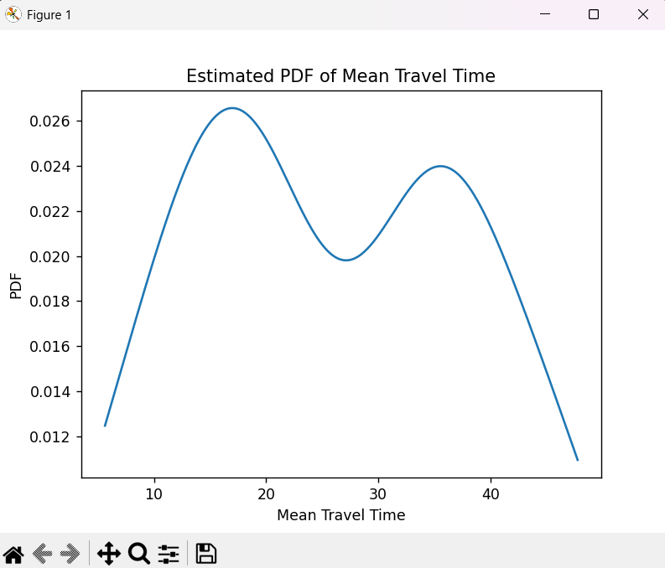
Probability Density Function / Cumulative Distribution Function
The curve indicates the PDF distribution for the 60 nodes sample
Peak → Common Travel Duration
Tail behavior reflects the reliability
fT​(t)

Slide 6
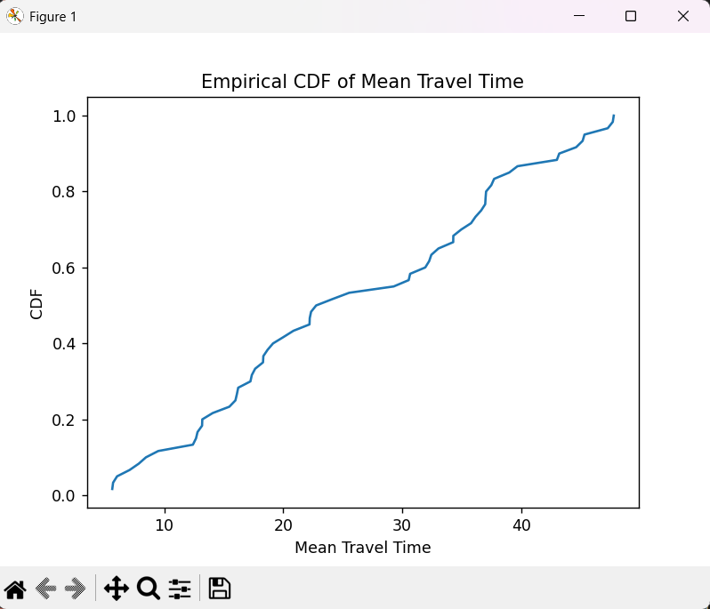
Probability Density Function / Cumulative Distribution Function
The curve indicates the Empirical CDF for the 60 nodes sample
Probability of arriving within time T
Staircase Approximation of the expected travel time
FT​(t)=P(T≤t)

Slide 7
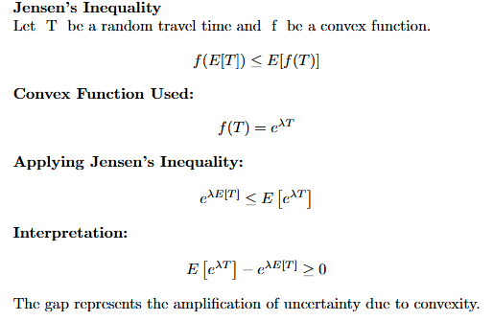
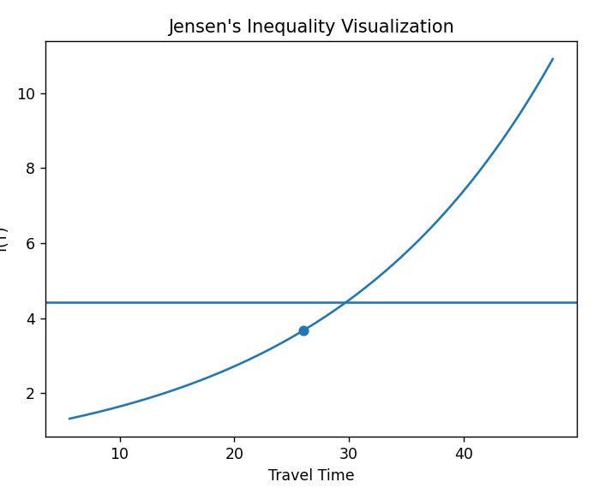

Jensen’s Inequality

Slide 8
Shift in optimization Objective
Classical routing: min E[T]
Stochastic On Time Arrival routing: max P(T≤D)
These objectives are fundamentally different
Expectation ignores uncertainty
Reability depends on full probability distribution

Slide 9
Jensen’s Inequality - Why Expectation Fails
For nonlinear function f: f(E[T])≠E[f(T)]
Arrival probability: P(T ≤ D)
Probability is nonlinear
Minimizing expected time does not maximize arrival probability
This justifies stochastic routing

Slide 10
Impect of Variability on Reliability
Even if: E[T1​] = E[T2​]
If: σ₁² < σ₂²
Then: P(T1​ ≤ D) > P(T2 ​≤ D)
Higher varience - lower reliability
Distribution shape matters, not just mean

Slide 11
Model Assumptions and Their Implication
Independence of edges
Time-invariant distributions
Exogenous uncertainty
Independence allows convolution
These assumptions ensure mathematical tractability
Real-world correlations may reduce accuracy

Slide 12
Key Insights
Reliability optimization is fundamentally different from expectation minimization
Nonlinearity of probability functional invalidates deterministic intuition
Variance and distribution shape directly influence decision quality
Jensen’s inequality provides formal justification
Stochastic routing is a risk-sensitive optimization framework
Niknami, M. and Samaranayake, S. (2016). Tractable Pathfinding for the Stochastic on-time Arrival Problem. In: Springer. pp.231–245.

